Slide 1
Predicting Control Energy Volumes for Grid Stability
Team BKW – Ra

Slide 2
Challenge / Goal
Develope a predictive model to forecast control energy activations for grid stability.
Automatic Frequency Restoration Reserve (afrr)

Slide 3
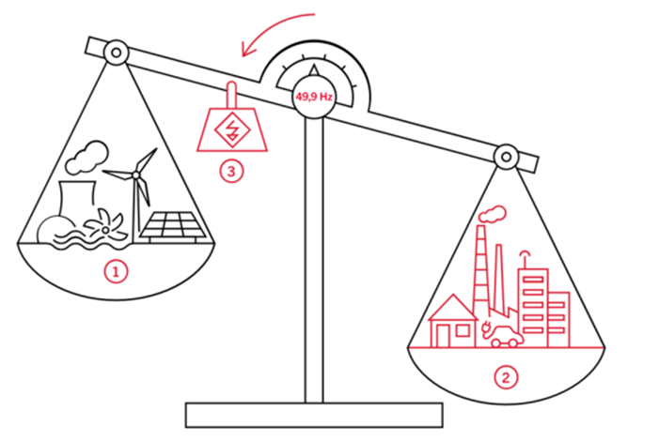
Control Energy Activation?

Slide 4
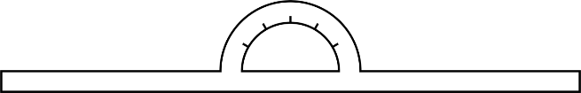
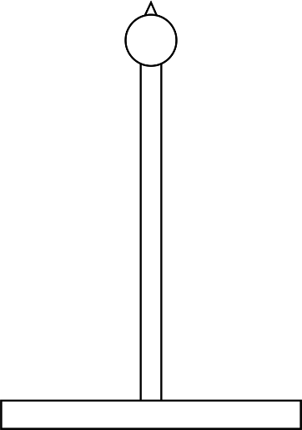






Control Energy Activation?
50,0 Hz
1
2

Slide 5
Control Energy Activations?
Primary
Secondary
Tertiary

Slide 6
Control Energy Activations?
Primary
Secondary
Tertiary

Slide 7
What is the Data about?
Fields:
TimeStamps
ActivatedBalancingVolume_CH_aFRR Positive and Negative
Generation (HydroLake, HydroPumpedStorage, HydroRunOfRiver, Solar, Nuclear, WindOnShore, Lignite, HardCoal, Gas) for CH, DE, FR, IT, AT where available
Consumption for CH, DE, FR, IT, AT
Boarder Flows CH-DE, CH-FR, CH-IT, CH-AT
NetTransferCapacity (NTC)

Slide 8



What did we explore?
Time / Calendar features
Weather
Cross-border

Slide 9
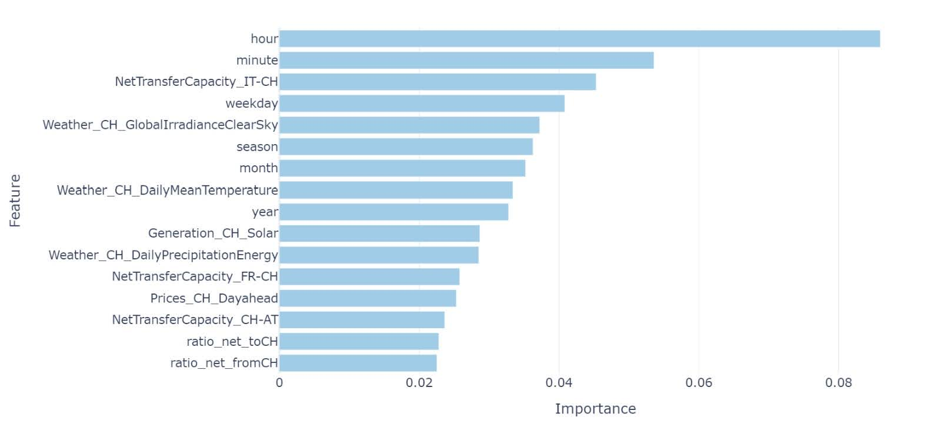
Relevant Features
Notes:
We did this, but in the end, we found out, that the model with the relevant featrues are not better than the model with only the calendar features.

Slide 10
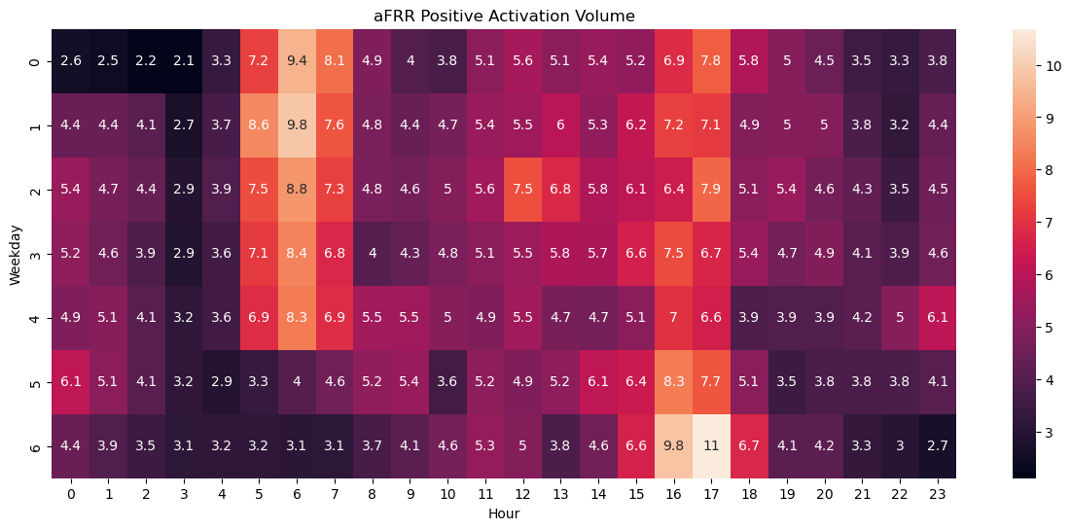
Daily Trend short term pos. balance
Mon.
Sun.
Notes:
Strong daily pattern in the mornings and in the evenings. Weekdays differ from weekends.

Slide 11
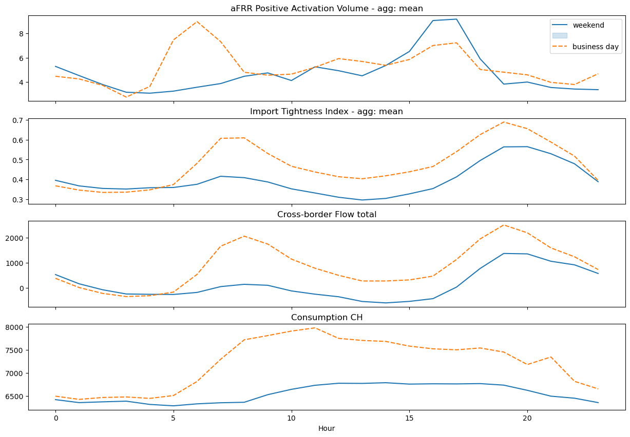
Imported Energy lags aFFR

Slide 12
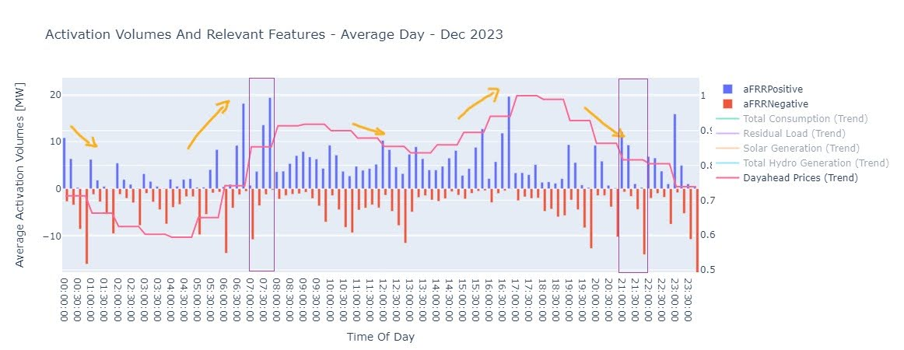
Ramp-up, Ramp-down
Notes:
Ask Rafa

Slide 13
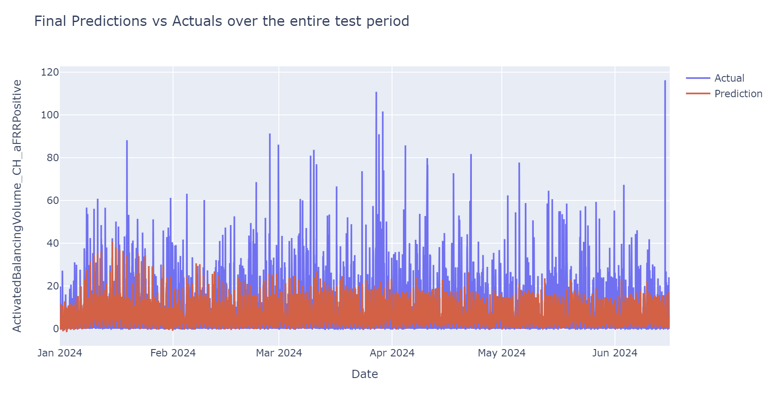
Shorttime forecast

Slide 14
Questions!!!
Why is it difficult to predict how much energy we consume in the morning and evening?

Slide 15
Conclusions / wrap-up
Next Step: forecast for the relevant features

Slide 16
Flow over NetTransferCapacity (NTC)
Notes:
We explored cross border flow

